Slide 1
Chapter 6
Intro to Internet protocol

Slide 2
DoD Model
DoD Model
OSI Model
Process/ Application
Application
Presentation
Session
Host-to-Host
Transport
Internet
Network
Network Access
Data Link
Physical
Notes:
Condensed version of the OSI model
It turns the 7 layers into 4 layers

Slide 3
TCP/IP Protocol Suite
DoD Model
Process/ Application
Telnet
FTP
LPD
SNMP
TFTP
SMTP
NFS
X Window
Host-to-Host
TCP
UDP
Internet
ICMP
ARP
RARP
IP
Network Access
Ethernet
Fast Ethernet
Gigabit
Ethernet
Wireless/802.11
Notes:
FTP(21): lets you transfer files across an IP network, it’s a program and a protocol
SSH(22): sets up a secure Telnet session over a standard TCP/IP connection; helps log into other systems and run programs on remote systems
Telnet(23): is a non-secure way to get on a remote client, DON’T use it
SMTP(25): Used to send mail
POP3(110): Used to receive mail
DNS(53): resolves hostnames and URLs to IP addresses
DHCP(UDP 67/68): assigns IP addresses to hosts; provides IP address, subnet mask, domain name, default gateway, and DNS)

Slide 4
Ports
Protocol | Port
File Transfer Protocol (FTP) | 20/21
SSH | 22
Telnet | 23
DNS | 53
Trivial File Transfer Protocol (TFTP) | 69
Simple Mail Transfer Protocol (SMTP) | 25
Post Office Protocol v3 (POP3) | 110
Internet Message Access Protocol v4 (IMAP4) | 143
HTTP | 80
HTTPS | 443
Simple Network Management Protocol (SNMP) | 161
Remote Desktop Protocol | 3389
Notes:
FTP: transfers files between systems, username & password authentication
Telnet: unencrypted way to gain access to remote devices
SSH: Same as Telnet, encrypted version
TFTP: stock version of FTP, it does nothing but send and receive files.
No ability to browse a directory
You need to know the exact name of the file to retrieve it
Don’t just learn the port numbers, also learn what each port is responsible for
SMTP: Send mail from server to server; can send mail from a device to a mail server; TLS port 587
POP3: Receive emails from a mail server; TLS port 995
IMAP4: More management of your inbox across all devices; TLS port 993
SNMP: Gather stats from network devices

Slide 5


DHCP Client four-step process
Client Broadcast DHCPDiscover
IP Address
Subnet Mask
Domain Name
Default Gateway
DNS
WINS Server Information
Server Unicast DHCPOffer
Client Unicast DHCPRequest
Server Unicast DHCPACK

Slide 6
Transport Layer Protocols
Transmission Control Protocol (TCP)
User Datagram Protocol (UDP)
Notes:
TCP: takes large blocks of information from an app and breaks it into segments
Has to setup a 3-way handshake prior to data transmission
Full-duplex, connection-oriented, and reliable
Time-consuming
UDP: Used primarily for real-time video
Doesn’t take up much bandwidth
UDP isn’t a bad protocol because reliability of data delivery can be handled at a different layer

Slide 7
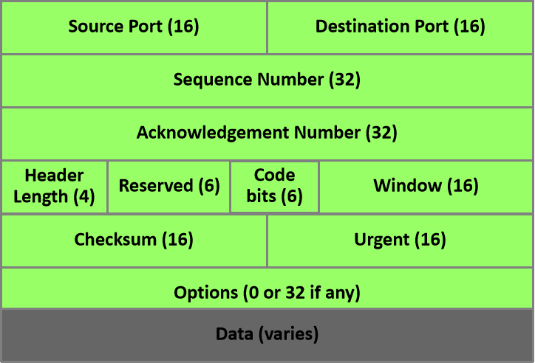
TCP Segment
Notes:
Source port: port number of the application of the host sending the data
Destination port: port number of the application of the destination host
Sequence number: A number used by TCP to put data back in the correct order or retransmit missing data
Acknowledgement number: TCP octet that is expected next
Header length: 32-bits
Payload(data): Handed down to the TCP protocol at the Transport layer

Slide 8
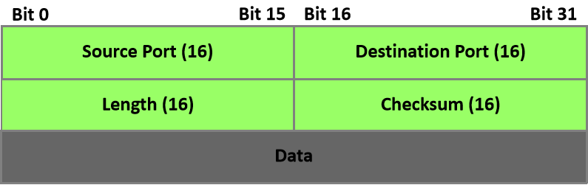
UDP Segment
Notes:
Low overhead, using far less resources

Slide 9
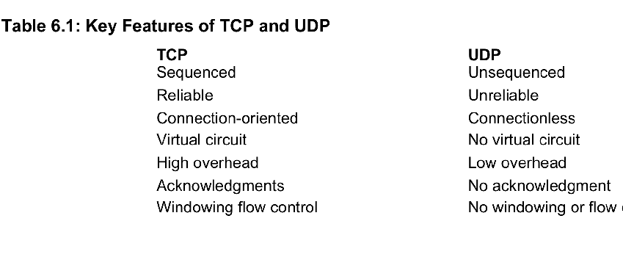
TCP and UDP

Slide 10
Internet/Network Layer Protocols
Internet Protocol (IP)
Internet Control Message Protocol (ICMP)
Address Resolution Protocol (ARP)
Reverse Address Resolution Protocol (RARP)
Notes:
IP: Looks at each packet’s destination address, then using a routing table, it decides where a packet gets sent next
ICMP: Acts as text messaging between devices, no data transfer; using the PING command
ARP: Finds the hardware address of a host from the known IP address
RARP: Discovers the identity of the IP address for diskless machines by sending out a packet including the MAC address to find out the IP address

Slide 11
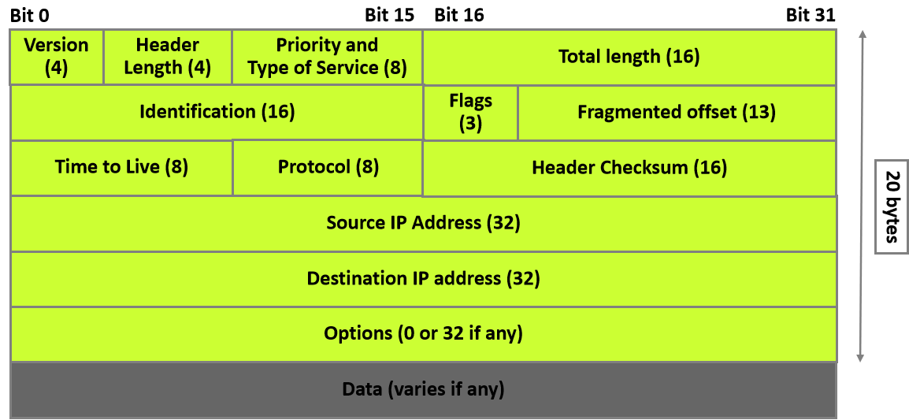
IP Header
Notes:
Information about the data that has been sent or received in the layers

Slide 12


ICMP Example
e0 on Lab_B is down. Host A is trying to communicate to Host B. What happens?
Lab_A
Lab_B
e0
e0
icmp
X
Host A
Host B
Notes:
Host A sends a packet for Host B
Lab B router sends an ICMP destination unreachable message back to the sending device
ICMP error message is sent ICMP: Its messages are carried as IP packets
5 common events of ICMP
1. Destination unreachable: if a router cant send an IP datagram any further
2. Buffer full: If a router’s memory buffer for receiving incoming datagrams is full
3. Hops: Each datagram has a certain number of hops (movement to another router) when it runs out, the last router to receive it will delete the data
4. Ping: sending an echo request to see if an IP address can be reached
5. Traceroute: TTL to discover the path a packer takes to reach its destination

Slide 13
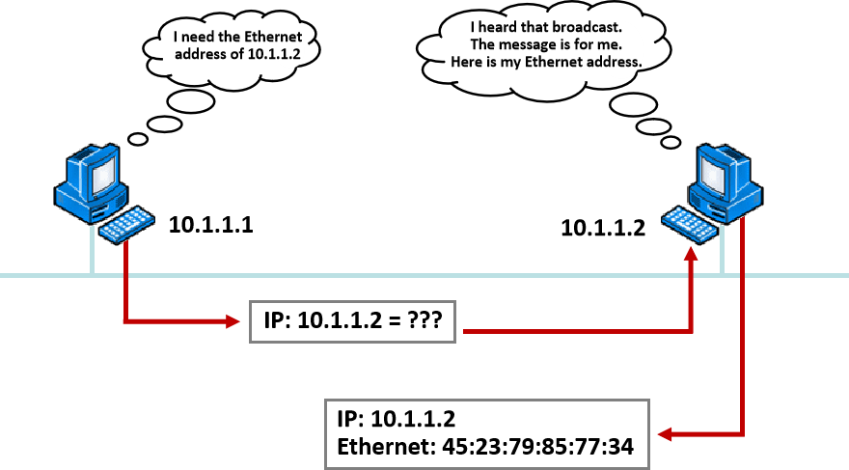
ARP Example

Slide 14

Reverse ARP Example
What’s my IP address?
I heard that broadcast. Your IP address is 192.168.10.3
Ethernet: 45:23:79:85:77:34 IP = ??
Ethernet: 45:23:79:85:77:34
IP: 192.168.10.3

Slide 15
Data Encapsulation
PDU
Application
Upper layer data
Presentation
Session
TCP Header
Upper layer data
Segment
Transport
IP Header
Segment
Packet
Network
LLC Header
Packet
FCS
Frame
Data Link
MAC Header
Packet
FCS
0101110101001000010
Bits
Physical
Notes:
Let’s review data encapsulation
1. User info is converted to data to be transmitted over the network
2. Data is converted to segments and a reliable connection is setup
3. Segments get converted into a packet, an IP address is placed in the header to be routed
4. Packets get converted to frames to be transmitted over the local network
5. Frames get converted into bits

Slide 16
Protocol Data Units
Segment
Source Port
Destination Port
…
Data
Packet
Source IP
Destination IP
Protocol
…
Segment
Frame
Destination MAC
Source MAC
Ether-Field
Packet
FCS
Bits
1011011100011110000
Notes:
This is a better breakdown of what units are at which levels of the DOD model

